Slide 1
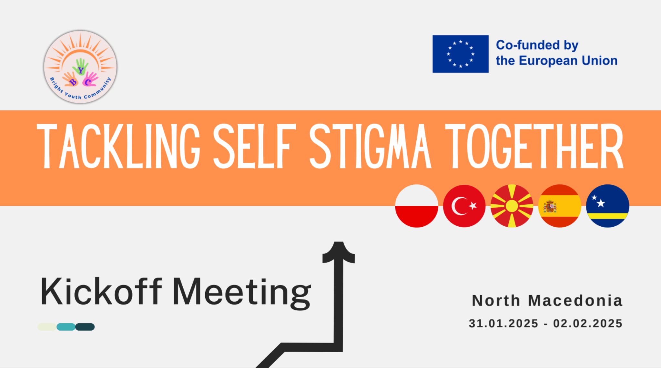
Sevilla
August 25-29, 2025

Slide 2


Tackling Self Stigma Together August 25-29, 2025 - Sevilla, SPAIN
Workshop, introduction to the Artificial Intelligence applications
True or False? – Quiz (10 min)
Expectations & Concerns Card (10 min)
Quick Idea Hunt (5 min)
Prototype Introduction & Testing (20 min)
What we need? Upcoming todo list (5 min)
Paper-Based New Feature Design (30 min)
Sharing & Group Presentation (40 min)
Sevilla
August 25-29, 2025

Slide 3

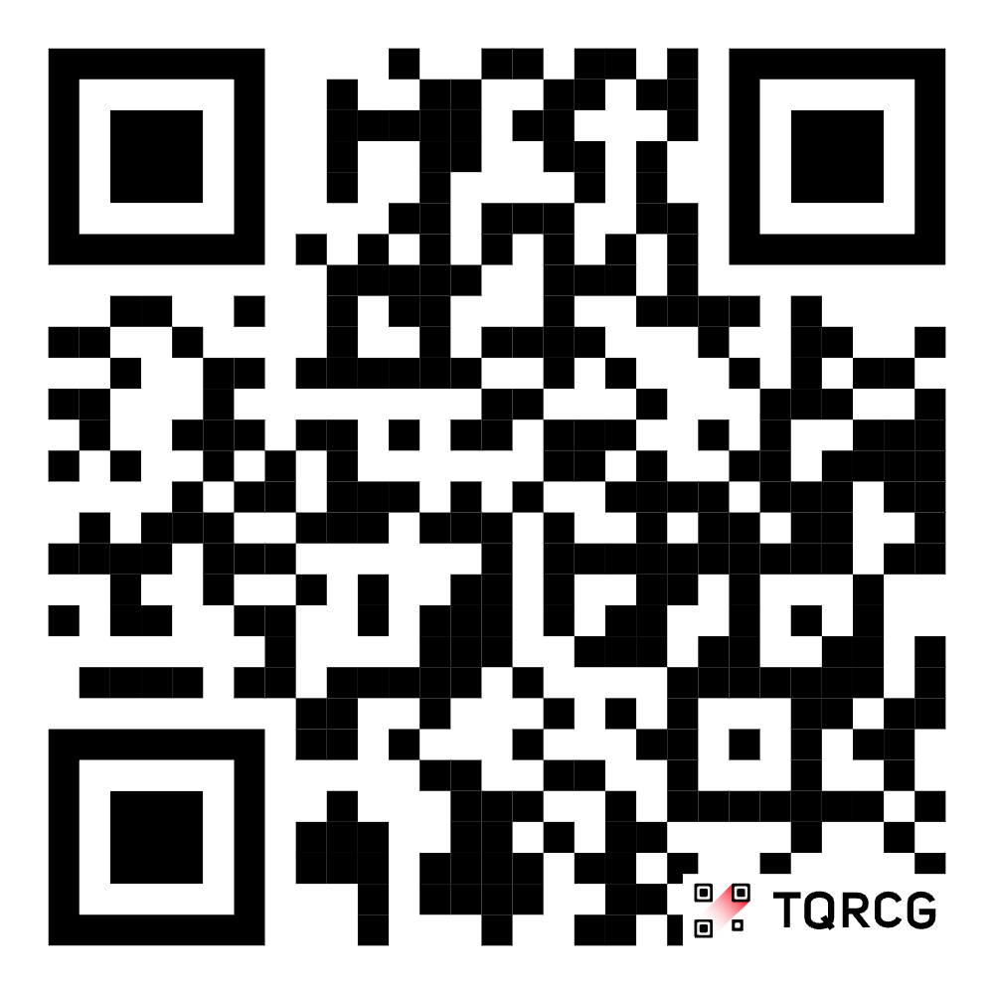
True or False? – Quiz

Slide 4


Expectations & Concerns Card

Slide 5
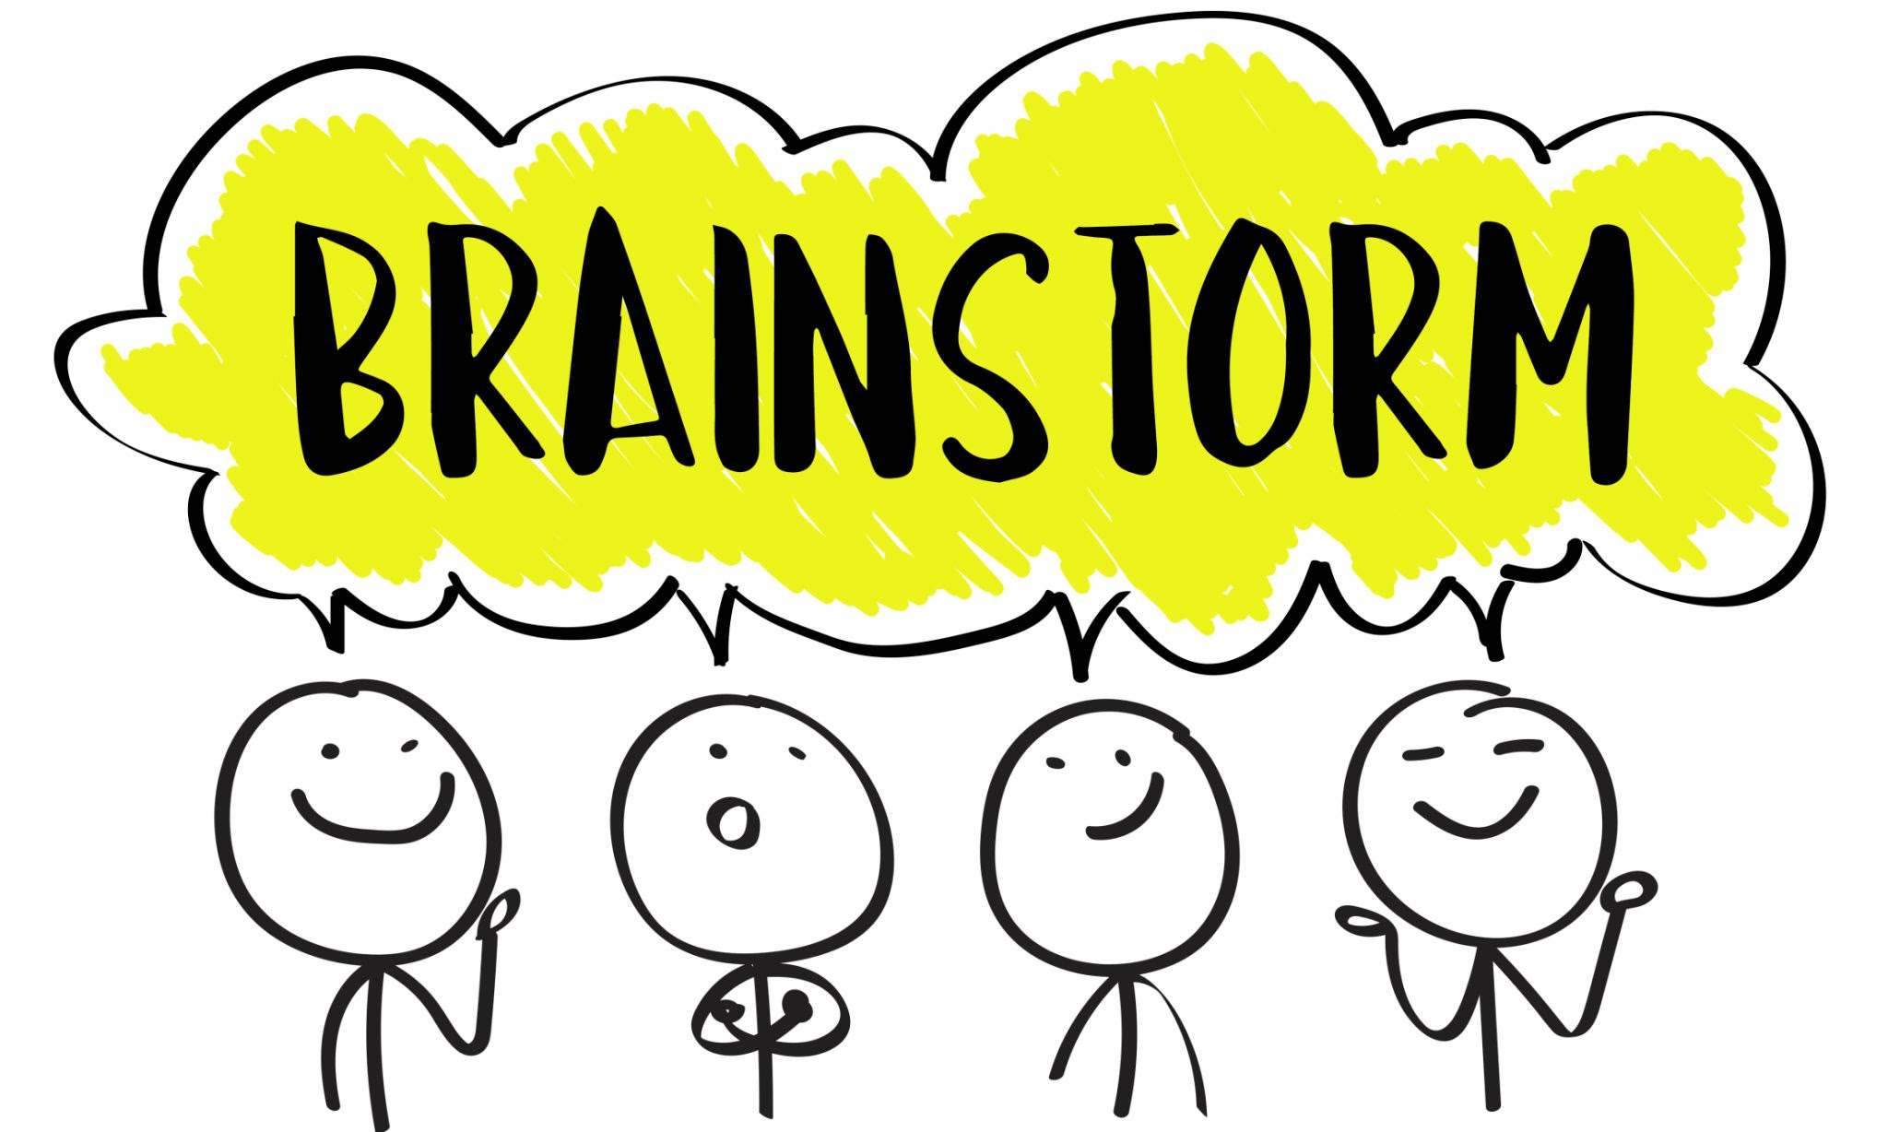
Quick Idea Hunt

Slide 6

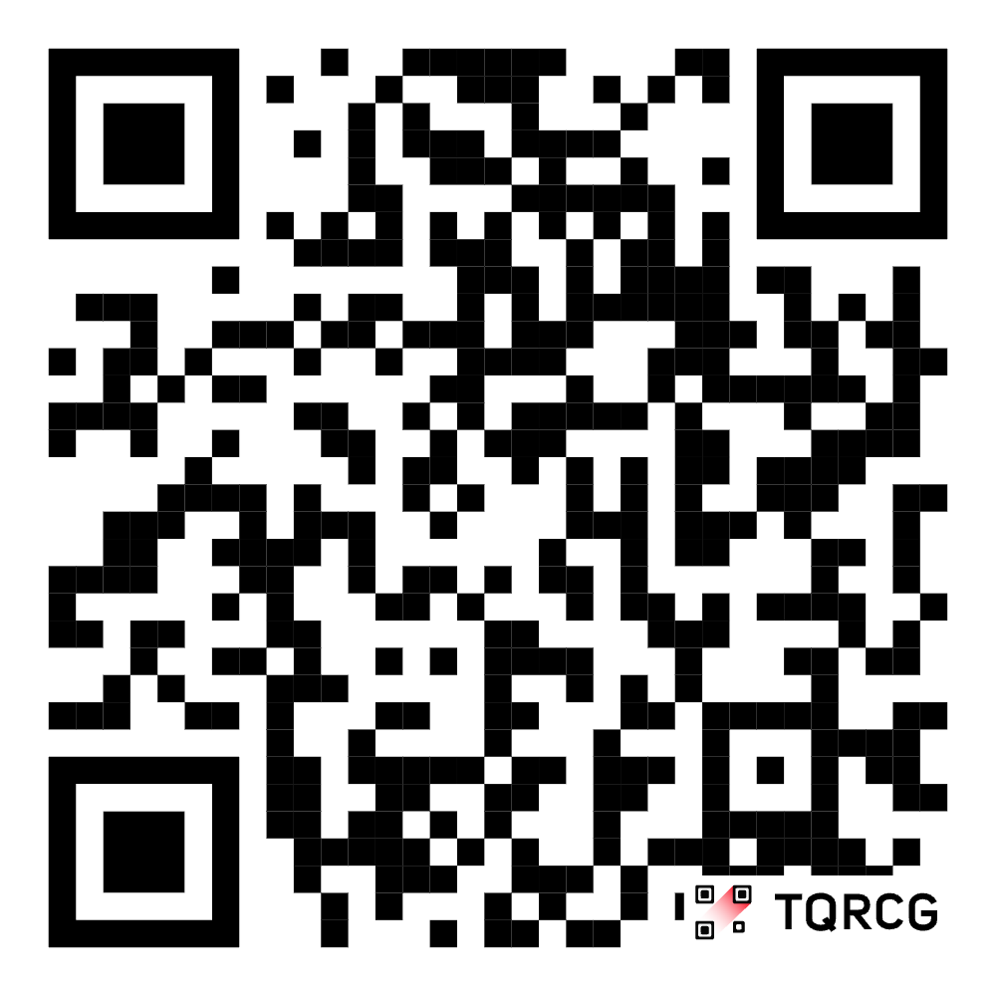
Prototype Introduction & Testing
Prototype Introduction & Testing

Slide 7

App Name & Icon
Prototype Introduction & Testing

Slide 8
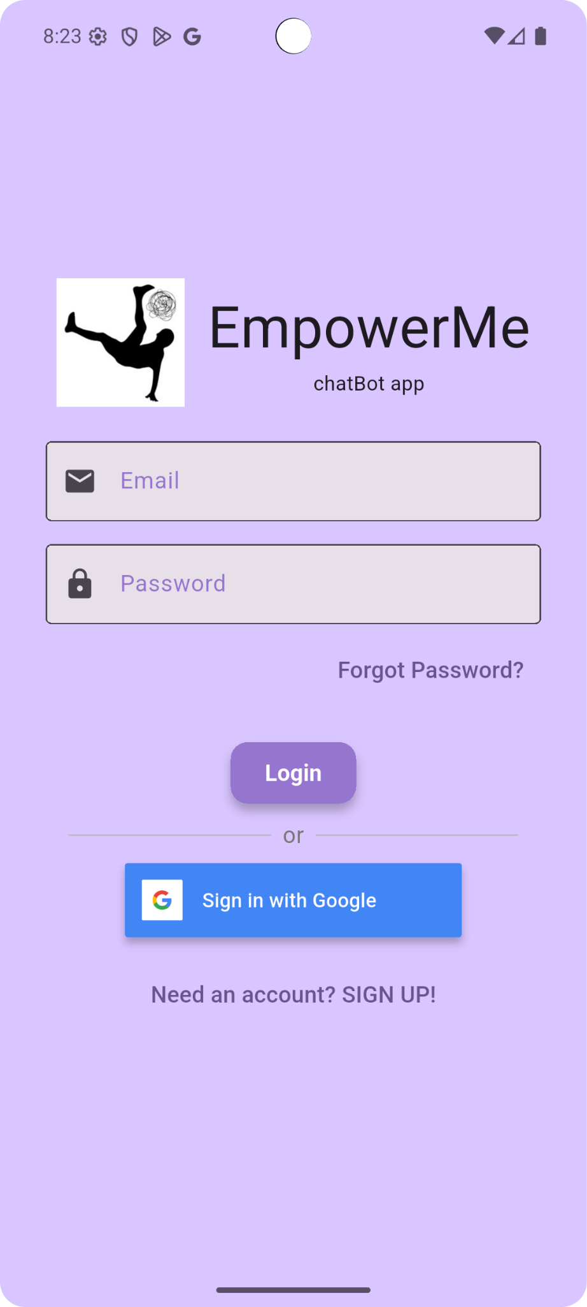
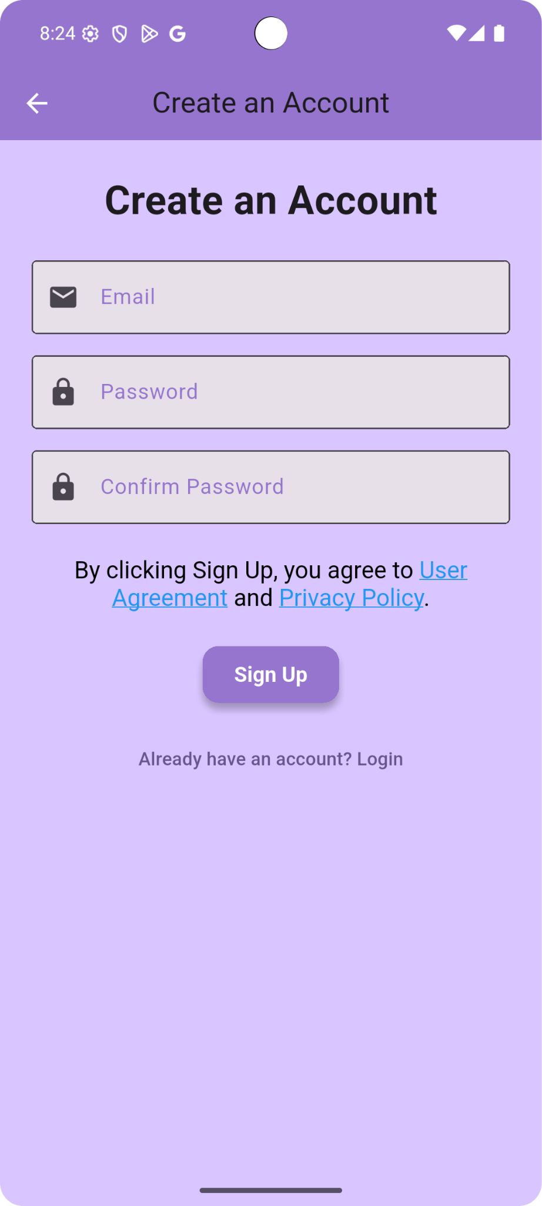

Login Page
Prototype Introduction & Testing

Slide 9
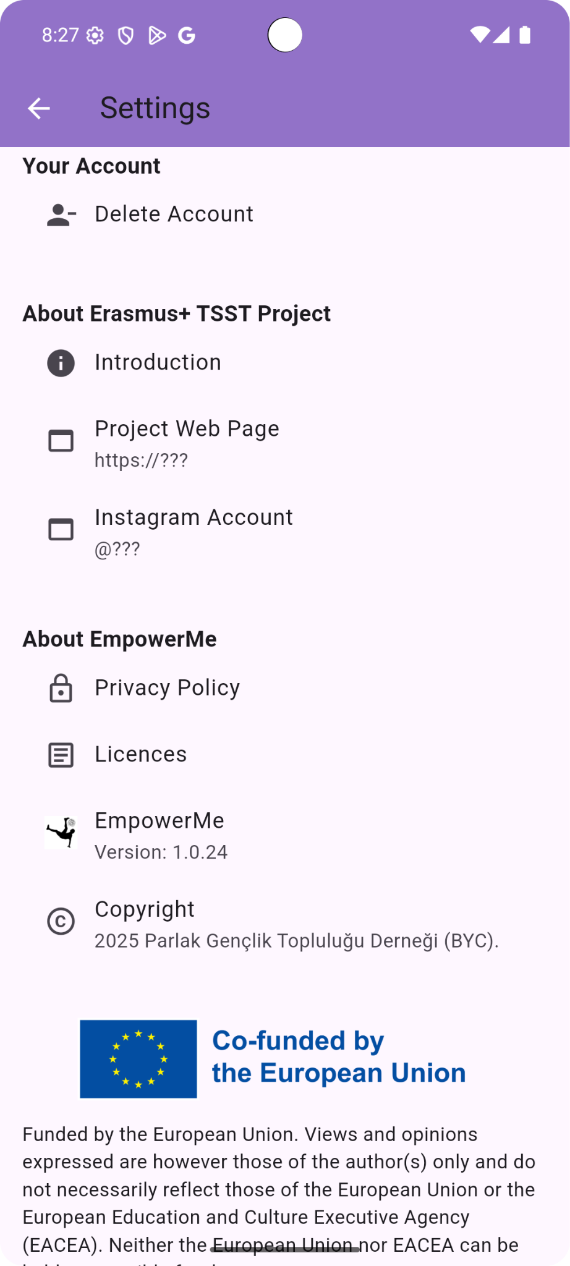
Settings Page
Prototype Introduction & Testing
Project Web Page ?
Project Instagram Account ?

Slide 10
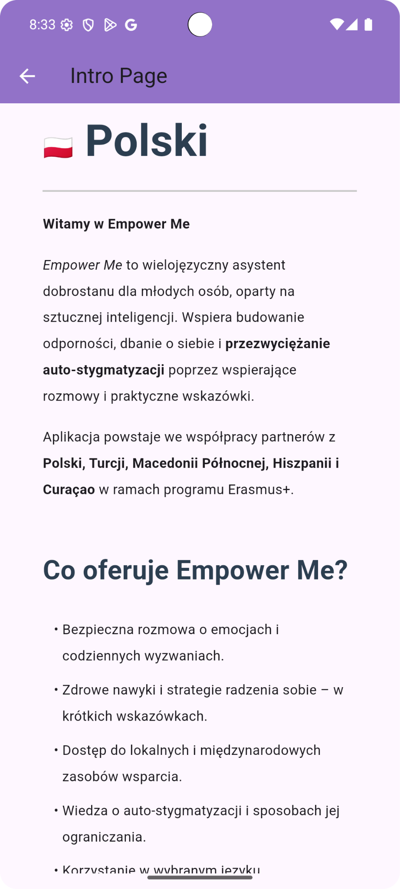
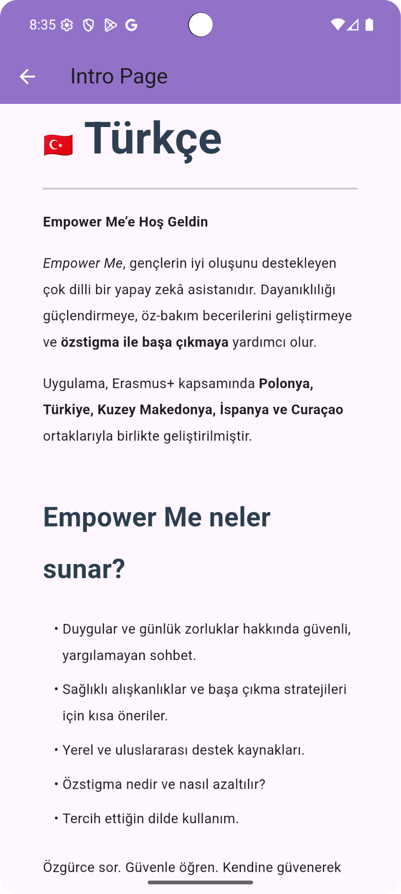
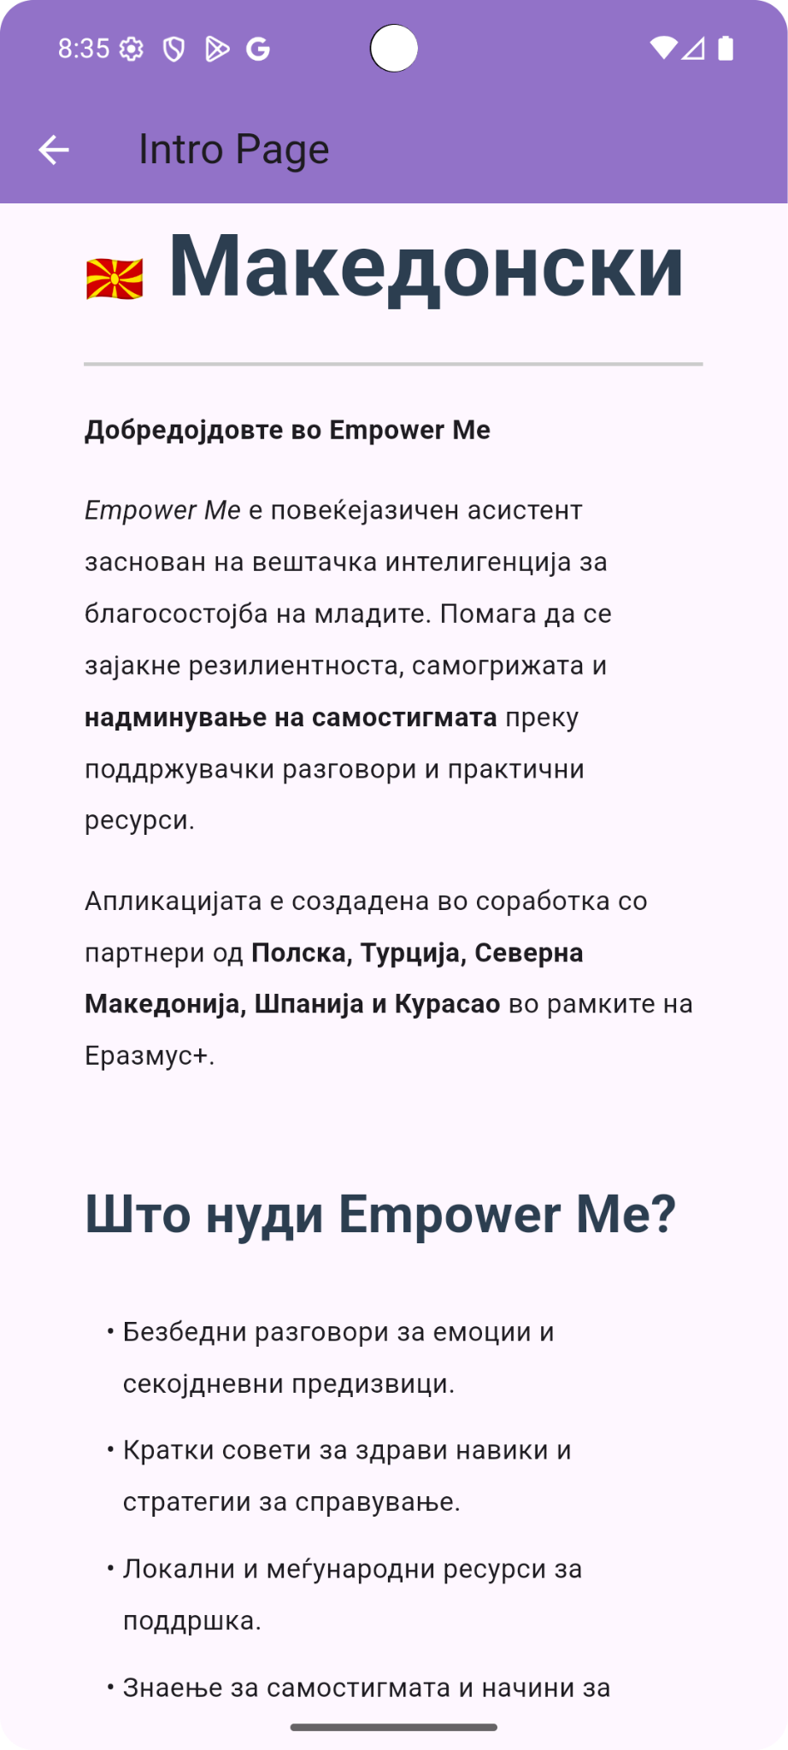
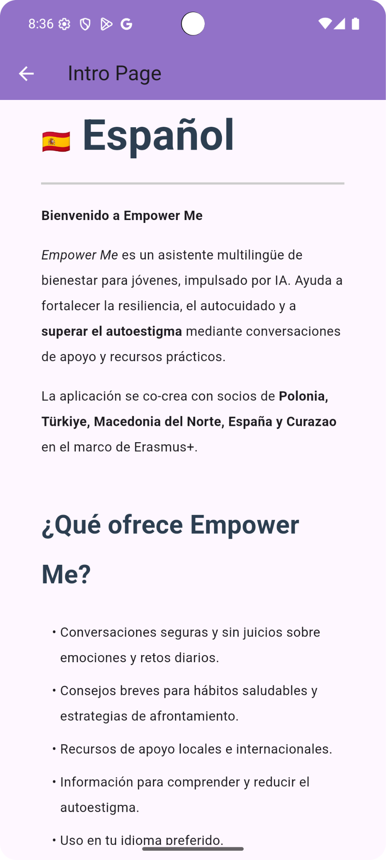
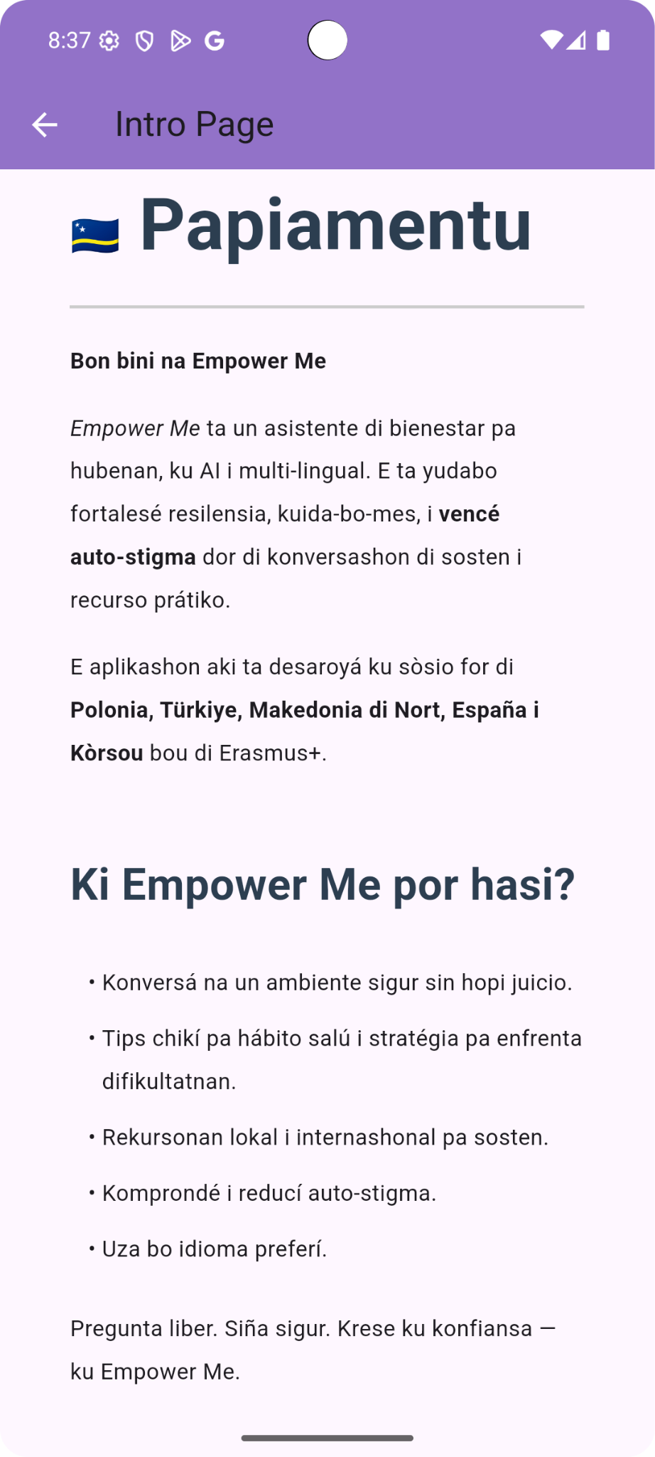
Settings Page / Introduction
Prototype Introduction & Testing

Slide 11
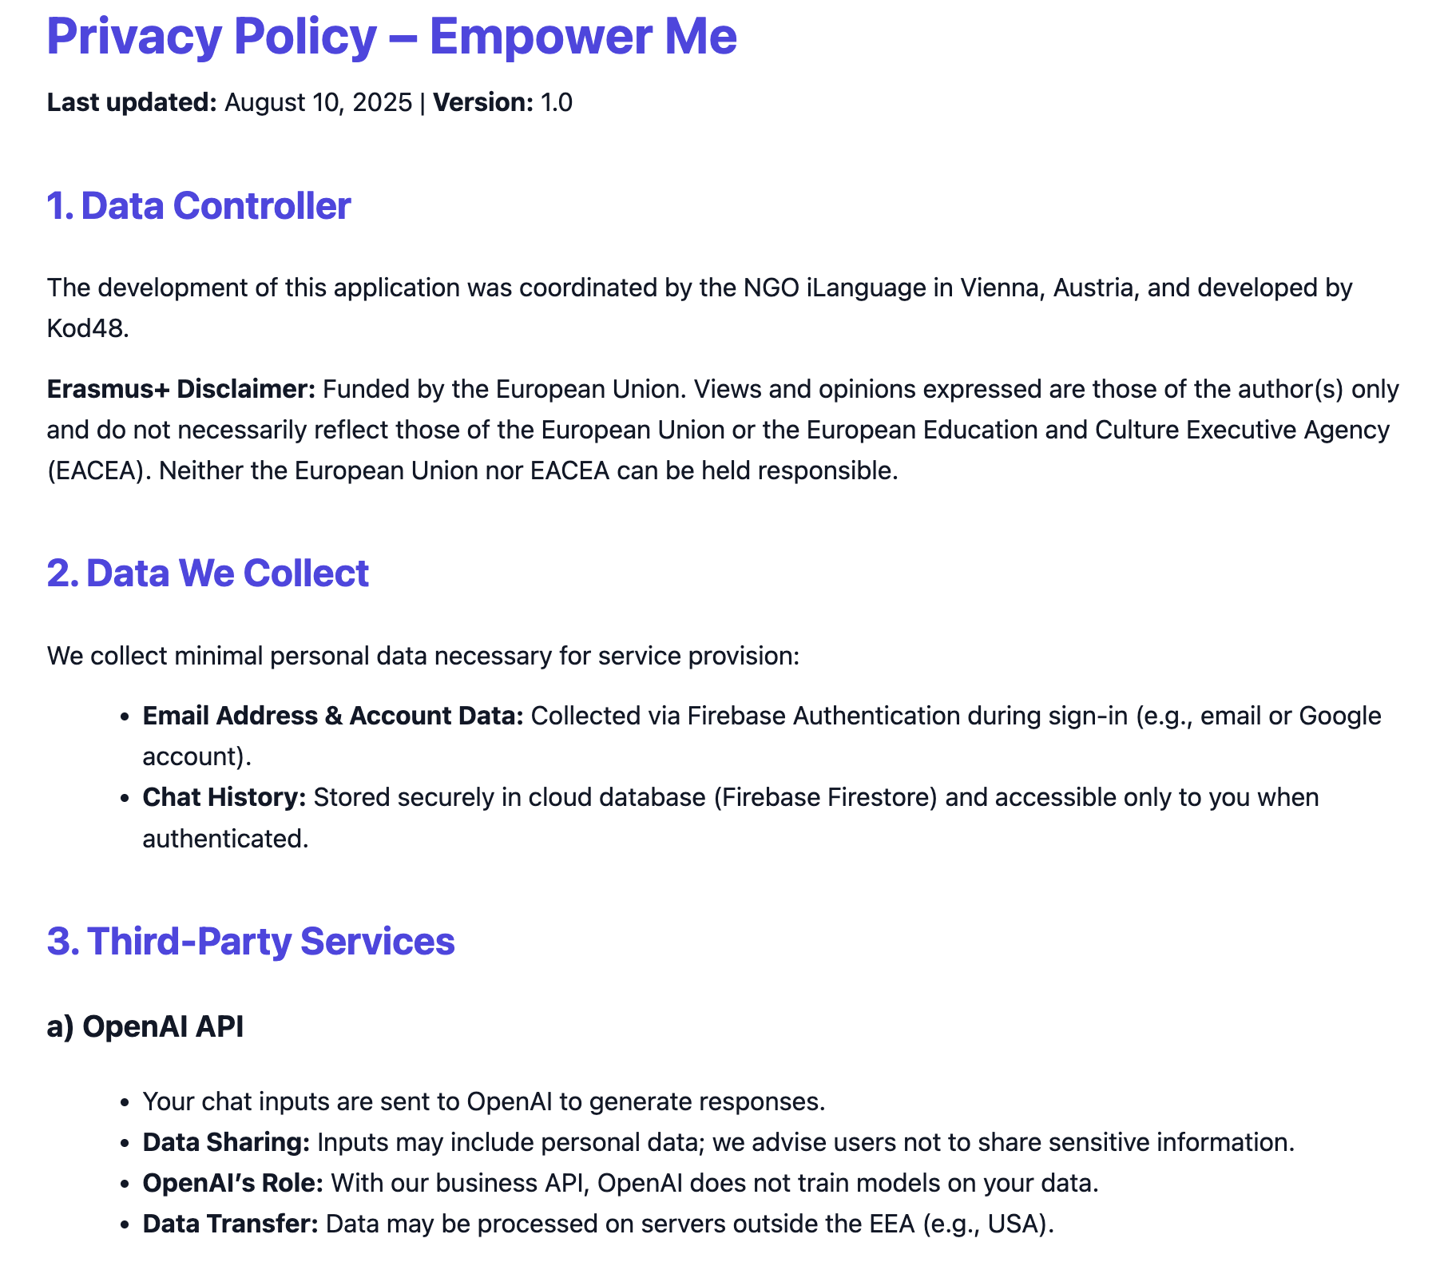
Settings Page / Privacy Policy
Prototype Introduction & Testing

Slide 12
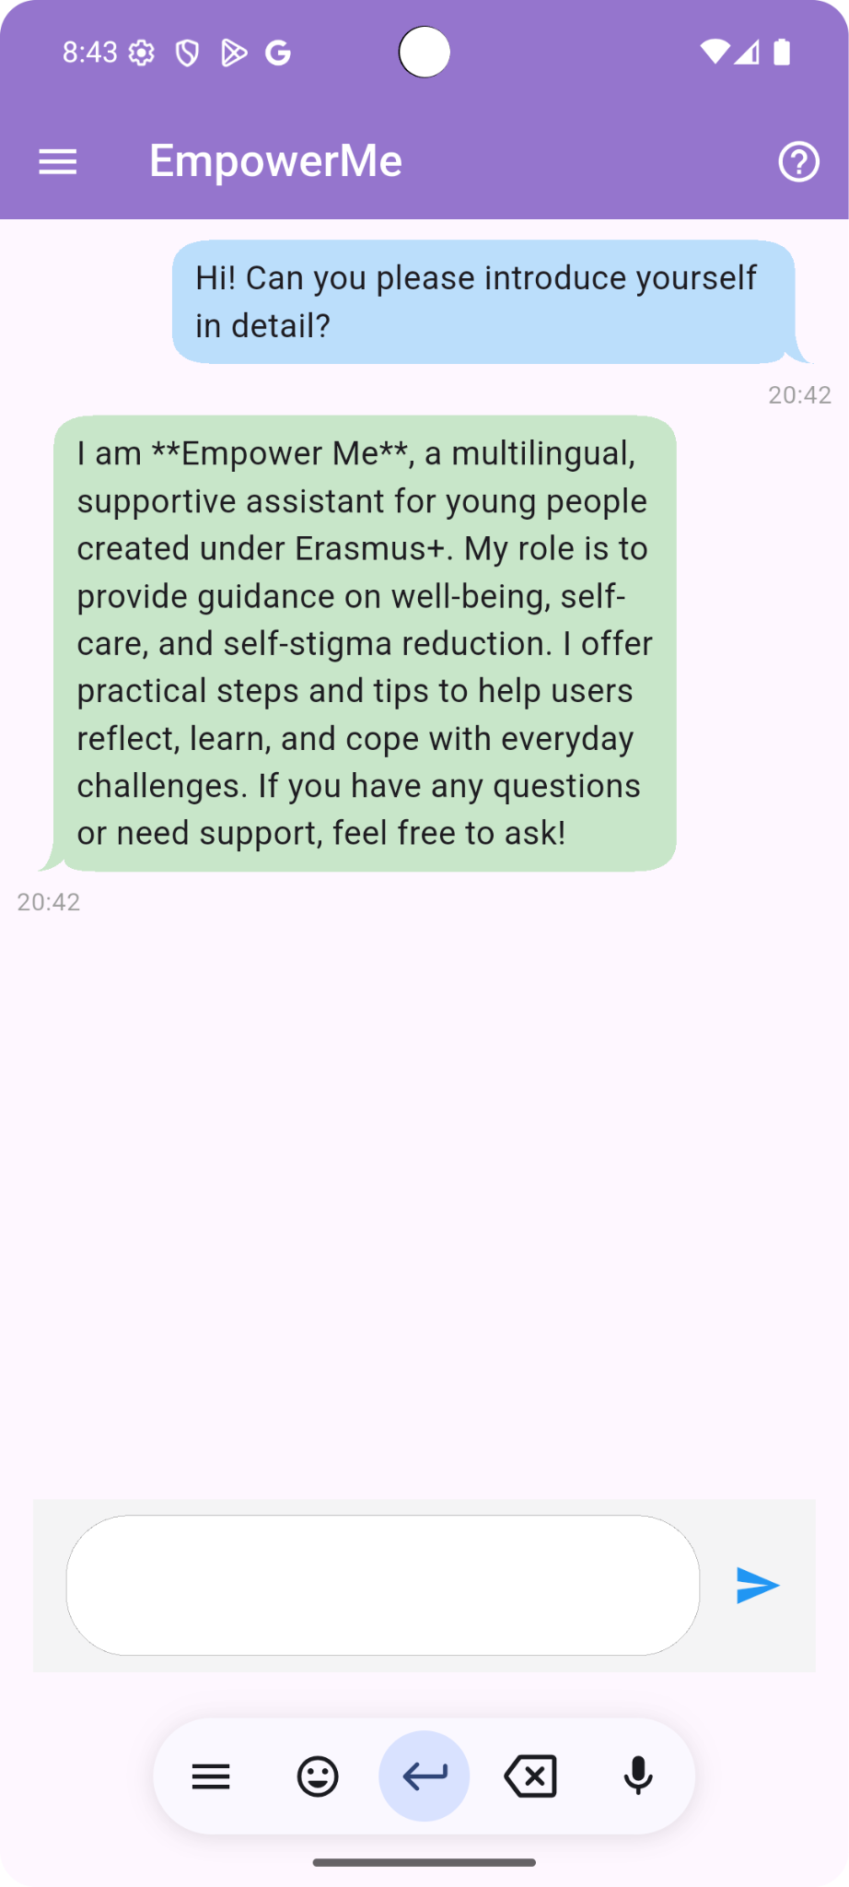
Settings Page / Chat Page
Prototype Introduction & Testing

Slide 13

Scenario: “Lina and the Unseen Weight”
Prototype Introduction & Testing
Profile:
• Name: Lina
• Age: 19
• Background: University student in her first year, studying computer science
• Location: Urban city, living in a student dorm
• Personality: Ambitious, perfectionistic, socially withdrawn lately
Story:
Lina was always a top student in high school, but since starting university, she’s been struggling with anxiety and depressive feelings. She notices her grades slipping, and she starts to believe that needing help would make her look “weak” or “incapable.”
On social media, her peers constantly share success stories, internships, and academic achievements. Lina compares herself to them and feels like she doesn’t belong in her field anymore.
When a friend suggested she talk to the university counselor, Lina said:
“I don’t want people to think I can’t handle life on my own. If they know I’m struggling, they’ll think less of me.”
This internalized belief — that struggling means she’s a failure — is a form of self-stigma. It keeps her from reaching out for support, even though she’s suffering.

Slide 14
We asked “EmpowerMe”
Prototype Introduction & Testing
I feel like everyone else is managing life better than me, and I’m just falling behind.
According to the provided background:
1. Stigmatized individuals may face status loss in society, leading to structural discrimination and potential negative coping responses.
2. Seeking psychological help is a common situation where stigma is intense, potentially affecting self-stigma and self-perception.
3. Psychological issues can contribute to self-stigma, delaying help-seeking and worsening mental health.
4. Mental health conditions perceived as more socially dangerous can lead to increased exclusion and distancing.
Try this:
1. Remember that everyone's journey is unique, and social media often portrays an idealized version of life.
2. Practice self-compassion by acknowledging your efforts and progress, no matter how small.
3. Reach out to a trusted person or mental health professional for support and guidance.
If you need more: How can you challenge negative self-perceptions and focus on your strengths to build resilience?

Slide 15
We asked “EmpowerMe”
Prototype Introduction & Testing
I get what you're saying, but how do I actually start seeing my strengths when all I can think about are my failures?
According to the provided background:
1. Self-stigma can lead to reduced self-esteem and decreased self-efficacy.
2. Self-stigma may cause individuals to focus more on their failures than their strengths.
Try this:
1. Practice self-compassion by acknowledging that everyone makes mistakes and has setbacks.
2. Keep a journal of your achievements, no matter how small, to shift your focus towards your strengths.
3. Challenge negative self-talk by replacing self-critical thoughts with more balanced and realistic ones.
If you need more: How do you usually react to setbacks or failures?

Slide 16
We asked “EmpowerMe”
Prototype Introduction & Testing
Honestly, when I fail at something, I just shut down and avoid trying again because I don’t want to feel that disappointment twice.
According to the provided background:
1. Self-stigma can impact self-esteem and self-efficacy.
2. Seeking help and having a positive attitude towards therapy can reduce self-stigma.
Try this:
1. Recognize that failure is a part of learning and growth. It doesn't define your worth.
2. Challenge negative thoughts about yourself by focusing on your strengths and past successes.
3. Consider seeking support from a trusted friend, mentor, or counselor to work through your feelings of disappointment.
If you need more support with overcoming the fear of disappointment and trying again, feel free to ask for guidance on building resilience and self-compassion.

Slide 17
We asked “EmpowerMe”
Prototype Introduction & Testing
I’m scared that if I open up to someone, they’ll see me differently and think I’m weak.
According to the provided background:
1. Self-stigma can lead to concerns about how others perceive us when we open up about our struggles.
2. It's common to fear being judged as weak or different when sharing personal challenges.
Try this:
1. Remember that opening up takes courage and strength, not weakness.
2. Choose someone you trust and feel comfortable with to share your feelings.
3. Start by sharing small bits of information to test the waters and gradually open up more.
If you need more: How comfortable do you feel with the idea of opening up to someone about your feelings?

Slide 18
Current Status
Prototype Introduction & Testing
It uses Open AI API (paid feature)
It needs more and more Academic Knowledge
We are gonna integrate new data in the upcoming mobilities, Curaçao and Türkiye activities.
We can design new features to make it richer
Ready to use
We can publish on the app marketplaces
Google Play
App Store

Slide 19

Paper-Based New Feature Design
Group Work

